Slide 1

Mini Project in C Bank Management System
Developing a Bank Management System using the C programming language requires clear understanding and deep knowledge of C programming concepts, memory management, and file handling techniques. The project involves creating a user-friendly system to manage bank accounts, transactions, and customer information.
TEAM MEMBERS
21BEC1085-VAMSHI S HARI HARA KIRAN REDDY J
21BEC1509-MADHAN KUMAR REDDY
21BEC1170-DEEPVANSH SRIVASTAVA
21BEC1312-VIGNESH
21BEC1003-HARSH PANDEY

Slide 2
Background
Provide an overview of the banking industry and the significance of computerization in modern banking systems.
Highlight the challenges faced by traditional manual banking systems, such as inefficiency, errors, and lack of scalability.
Introduce the importance of developing a computerized banking system to address these challenges and enhance customer experience.

Slide 3

Literature Survey
Key Themes: Banking management systems literature focuses on technological advancements, security, customer relations, data analytics, regulatory compliance, customer experience, and future challenges.
Importance of Innovation: Emphasizes the need for innovation, automation, security, and data analysis to improve efficiency, compliance, and customer satisfaction while addressing challenges like legacy systems and cybersecurity threats.

Slide 4

Problem Description
Outline the specific challenges and limitations of the manual banking system that your project aims to address.
Discuss common issues such as manual data entry errors, slow processing times, difficulty in tracking transactions, etc.
Emphasize the need for automation and computerization to improve efficiency, accuracy, and customer satisfaction.

Slide 5
Methodology
Describe the approach or methodology used in developing the computerized banking system.
Explain the steps involved in designing, implementing, and testing the system.
Provide an overview of the software development lifecycle (SDLC) model or methodology adopted for the project (e.g., waterfall, agile, etc.).

Slide 6
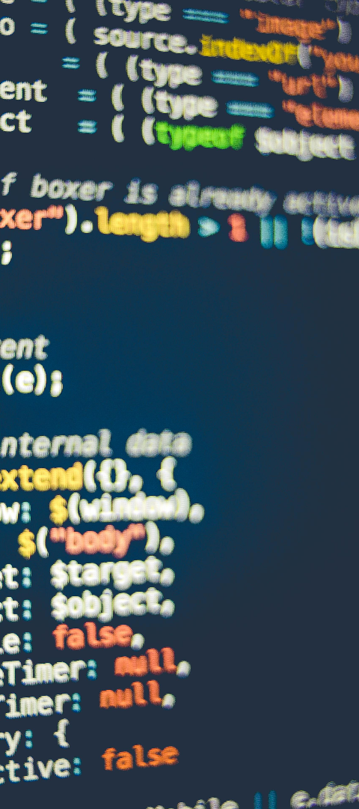
Tools
1
IDE Selection
2
Version Control
Choosing a suitable Integrated Development Environment (IDE) for C programming such as Visual Studio or Code::Blocks.
Implementing version control with Git to manage the project's source code and collaborate efficiently.
3
Documentation
Utilizing tools like Doxygen for clear and detailed documentation of the C bank management system project.

Slide 7
References
50+
10
5
Research Papers
Books Consulted
Online Resources
Around 50+ research papers and academic articles reviewed for in-depth understanding and knowledge acquisition.
Referenced 10+ authoritative books and resources related to bank management systems and C programming.
Explored and utilized 5+ online resources such as forums, blogs, and educational websites for diverse perspectives and insights.

